Slide 1
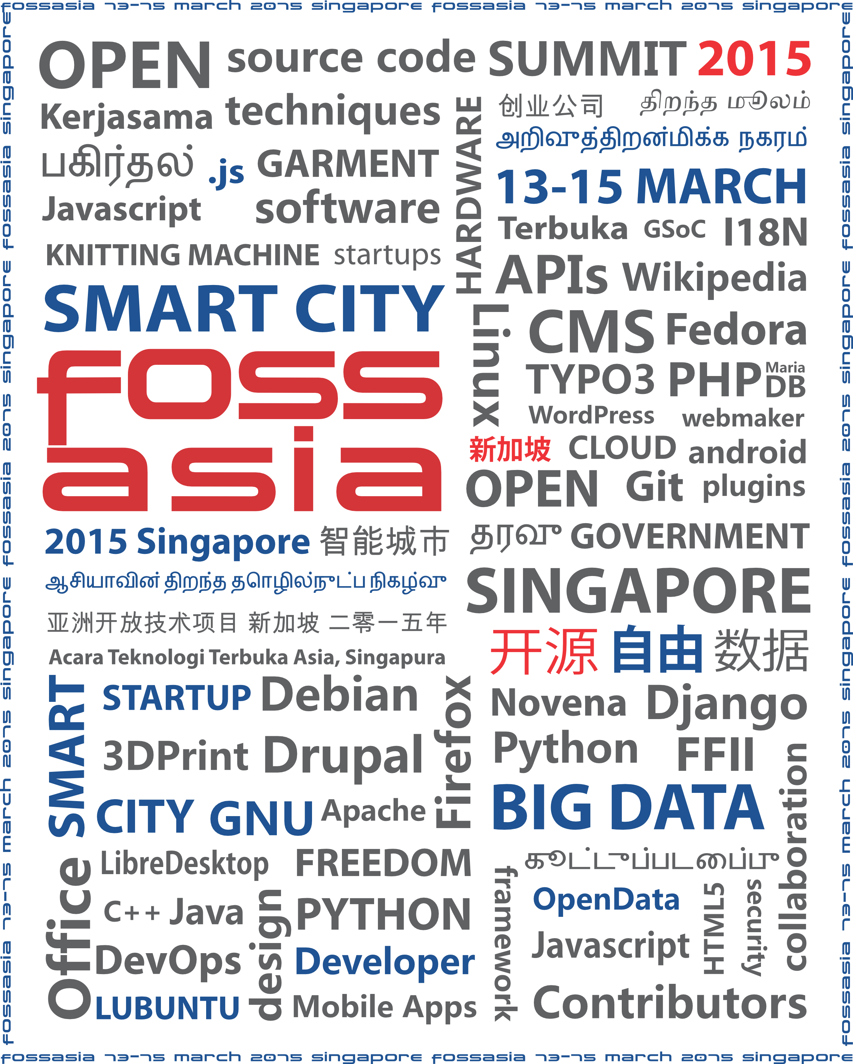
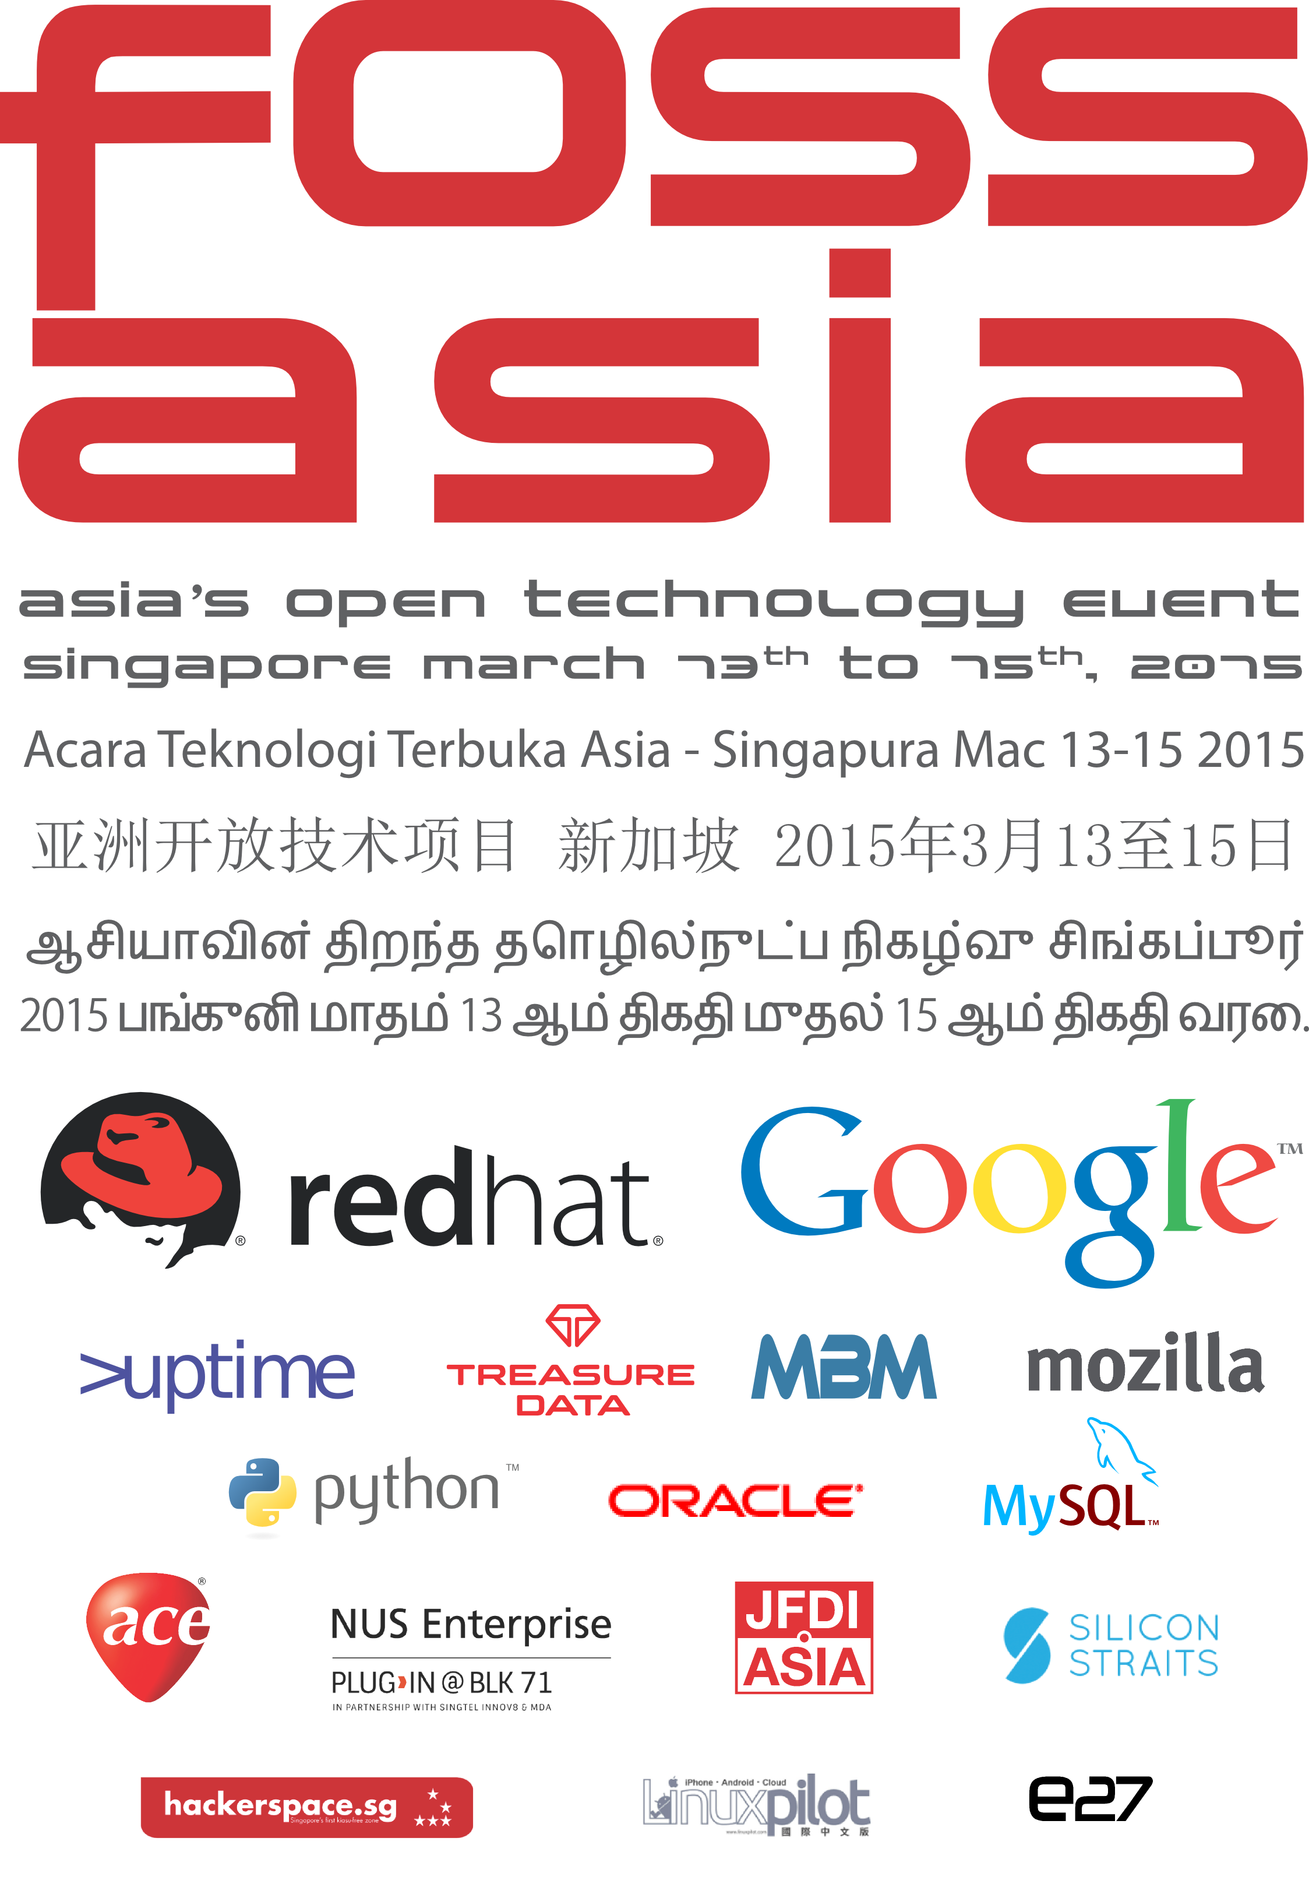

Slide 2

9:30 AM Welcome
Hong Phuc Dang, Mario Behling (FOSSASIA)
9:35 AM Open Technologies in Singapore
Harish Pillay (Internet Society Singapore / RedHat)
9:40 AM Novena and Open Hardware Development
Keynote
Bunnie Huang (Bunnie Studios)
10:00 AM systemd: Where We Come from, and Where We Want to Go in 2015
Keynote
Lennart Poettering (Red Hat)
10:25 AM The Power Of Free: How LiMux serves 15.000
Stefan Koehler (CronusConsult)
10:45 AM Shout-Outs
William Hooi, One Maker Group / Veerappan Swaminathan, Sustainable
Living Lab / Thomas Gorissen, Skylink.JS / Shilpa S Nath, e27
10:55 AM Snack Break

Slide 3
11:10 AM MariaDB - State of the Base
Keynote
Colin Charles (MariaDB)
11:35 AM How Mozilla launches the Firefox OS open web mobile platform in Asia and how you can get involved
Keynote
Gen Kanai, Mozilla
12:00 PM Distributed Search and Open Index with Loklak
Michael Christen (LokLak, Core Developer Yacy)
12:15 PM Lunch Break
1:15 PM Cutting Through The Container Hype
Brian Proffitt (Red Hat)

Slide 4
1:15 PM Cutting Through The Container Hype
Brian Proffitt (Red Hat)
1:45 PM Open Source Monitoring with Icinga
Bernd Erk (Icinga)
2:00 PM Singapore as a Smart Nation
Keynote
Dr. Vivian Balakrishnan
Minister for Environment and Water Resources and
Minister-in-charge of Smart Nation
2:30 PM Coffee and Tea Break
2:45 PM Abusing Mobile Phones to Make the Internet of Things
Jan Jongboom (Telenor Digital)

Slide 5
2:45 PM Abusing Mobile Phones to Make the Internet of Things
Jan Jongboom (Telenor Digital)
2:55 PM Open Data Platform based on CKAN
Emily Chen (GNOME Foundation)
3:05 PM Exciting days With Python
Kushal Das (Python Software Foundation)
3:15 PM VLC Media Player: News and Future
Rémi, Denis-Courmont (VideoLAN)
3:25 PM Yahi: Crowd-Sourced Haze-Mapping, Internet of Things and Real-Time Open Data
Roland Turner (Yahi)

Slide 6
3:35 PM Soft Digital Fabrication
Mar Canet (Knitic)
3:55 PM The State of the Dolphin
Ryusuke Kajiyama (Oracle Japan)
4:15 PM Collaborate with ease and Confidence
Georg Greve (Kolab Systems)
4:35 PM COPE CMS "Create Once, Publish Everywhere"
Rasmus Skjoldan (TYPO3)
4:55 PM Thank you and Outlook for day two and day three
Hong Phuc Dang
4:55 PM End of Sessions
6:00 PM Labrador Park Social Event

